Slide 1
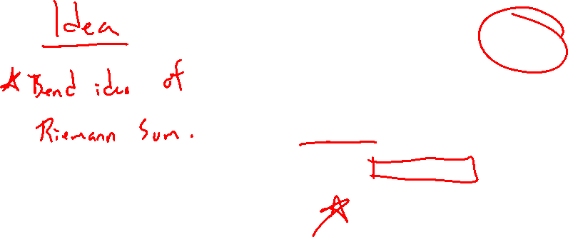
Section 8.1 Arc Length
Lecture 1
Formula Derived

Slide 2

Section 8.1 Homework Submission to Canvas
Preview of section
Skim the section in text and write a short paragraph summary.
Give a bulleted list of all important definitions, theorems, and formulas without details.
Notes on video lectures
Take notes on everything written on slides including all details, worked examples, on-own activities, as well as your own thoughts and questions.
Try on-own activities first, then write down provided solution next to it for comparison.
Worked examples from the text
Write down the problem and attempt without looking at the solution.
Use the solution to write the best explanation you can.
Solutions to textbook exercises
Model approaches and explanations given in the video lectures and textbook examples.
Final reflection of section
List the key takeaways to remember as a bulleted list.

Slide 3
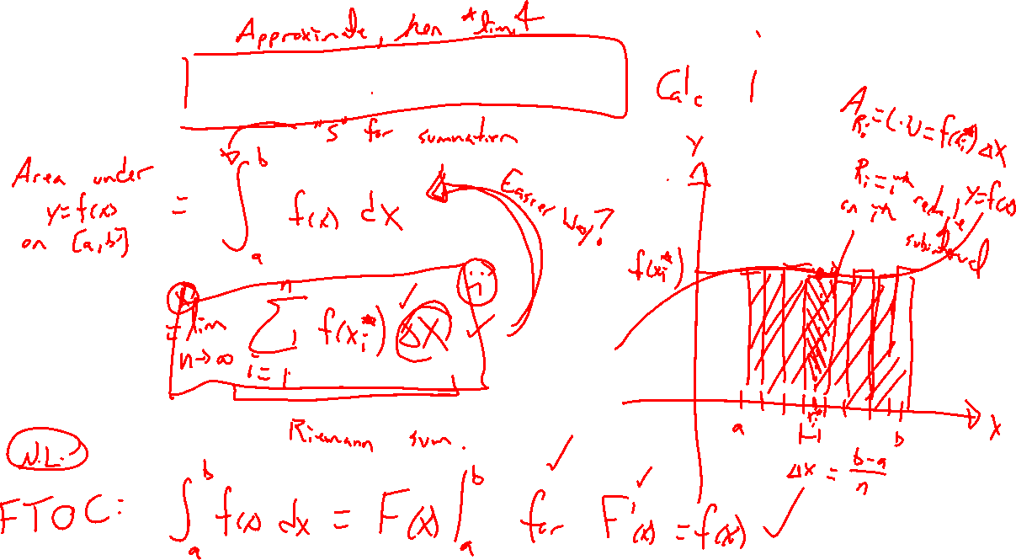
Recall: Riemann and his Sum
Notes:
Refresh definite integral, abandoned this idea for FTOC

Slide 4
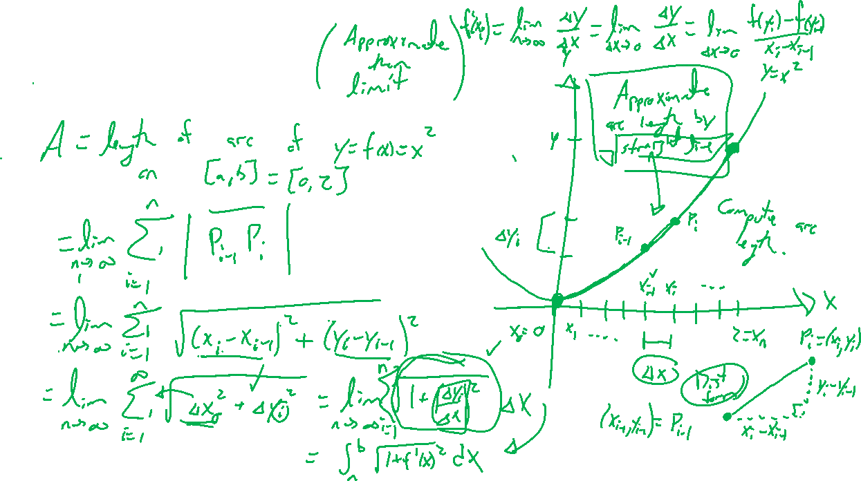
Arc Length Idea
Notes:
Find arc length of y=x^2 for x on [0,2]
Approach: Approximate by line segments, take limit of number of segments to infinity
General points P_I and P_{I+1}, distance formula, rewrite as \Delta x, \Delta y and factor out \Delta x

Slide 5
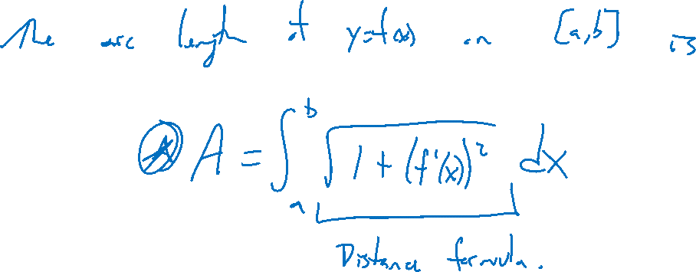
Arc Length Formula

Slide 6
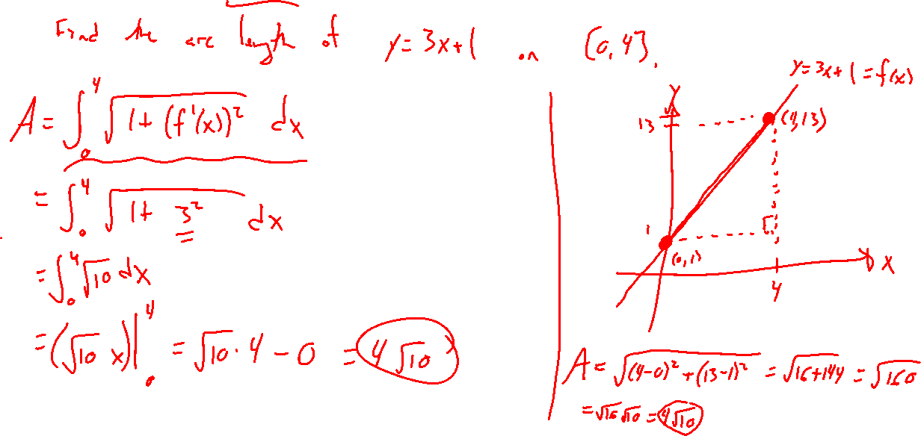
Example: Basic
Notes:
Y = 3x+1 on [0,4], double check with Pythagoras

Slide 7
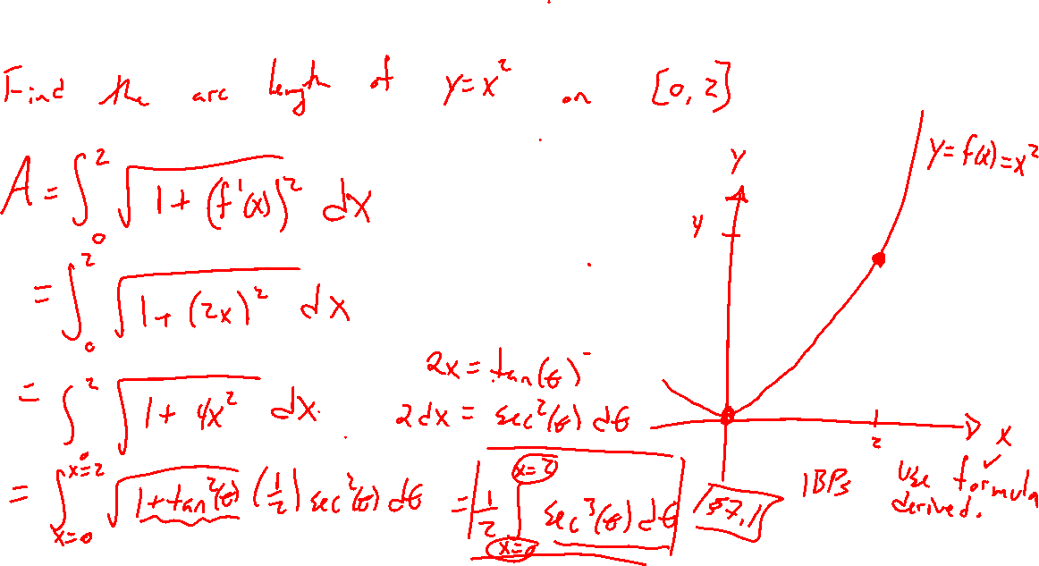
Example: Try on Own
Notes:
Finish what started, y=x^2 on [0,2]

Slide 8
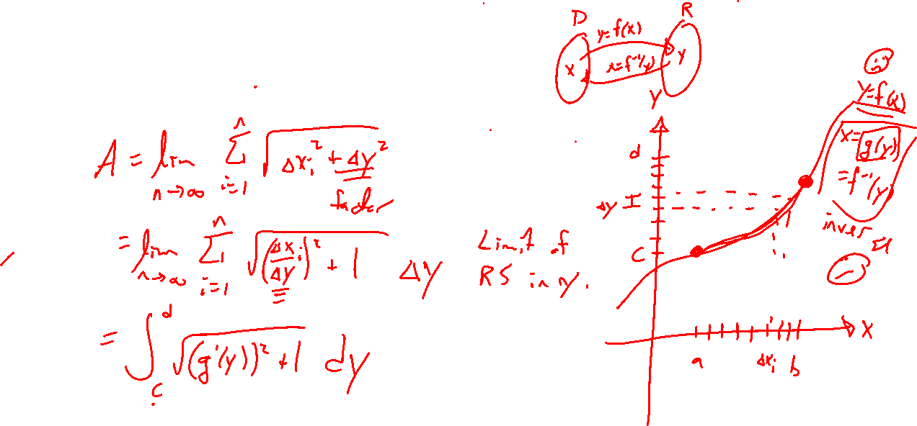
Arc Length in Y
Notes:
Rewrite as an integral in y.
Choice of direction is good if one way is hard.

Slide 9

Section 8.1: Textbook Examples and Exercises
Rework examples 1, 2, 4 in the text. Steps:
Write down a problem.
Close the book and attempt on own.
Check / correct your solution against the text solution.
If needed, rewrite the problem to be of the quality of the text solution.
Complete exercises: 11, 13, 19
Write solutions of the same quality as in lecture and text solutions.
Check your solution against the answer in the back of the book.

Slide 10

Section 8.1 Homework Submission to Canvas
Preview of section
Skim the section in text and write a short paragraph summary.
Give a bulleted list of all important definitions, theorems, and formulas without details.
Notes on video lectures
Take notes on everything written on slides including all details, worked examples, on-own activities, as well as your own thoughts and questions.
Try on-own activities first, then write down provided solution next to it for comparison.
Worked examples from the text
Write down the problem and attempt without looking at the solution.
Use the solution to write the best explanation you can.
Solutions to textbook exercises
Model approaches and explanations given in the video lectures and textbook examples.
Final reflection of section
List the key takeaways to remember as a bulleted list.

